Slide 1
CYCLIST BIKE SHARE ANALYSIS
File created on: 7/10/2024 8:59:46 PM

Slide 2
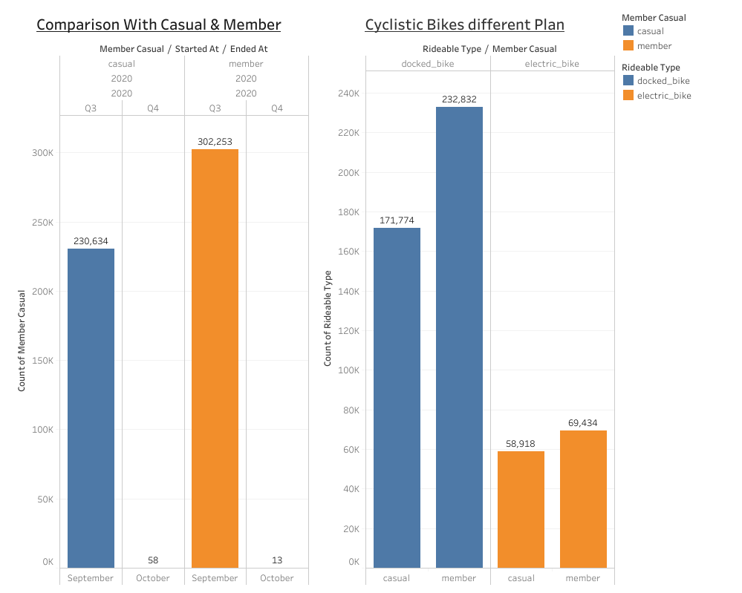

Slide 3
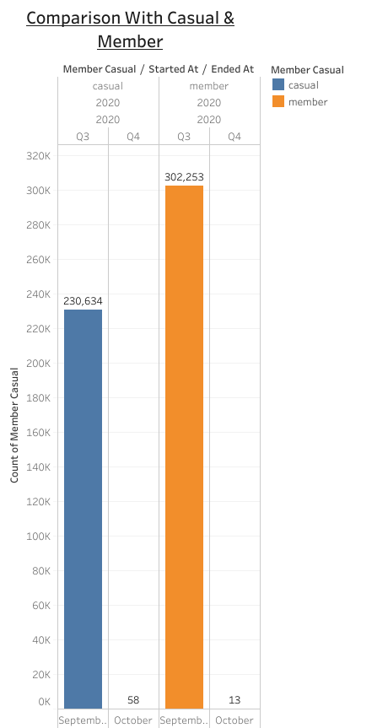

Slide 4
